Slide 1

Team Name : Falcons
Team Leader Name : Soham Awaze
Problem Statement : Schizophrenia diagnosis is subjective and delayed because it relies heavily on behavioural observation instead of measurable biomarkers.

Slide 2
Team Members
Team Leader: Name: Soham Awaze College: JD college of Engineering and Management LinkedIn:https://share.google/ppuSChaIUIjSFcxWQ
Team Member 1: Name: Kavya Balsaraf College: JD college of Engineering and Management LinkedIn: https://www.linkedin.com/in/kavya-balsaraf-7249713aa/ | Team Member 3: Name: Samarth Pathare College:JD college of Engineering and Management LinkedIn:https://www.linkedin.com/in/samarth-pathare-b922042b2/
Team Member 2: Name:Nachiket Bawankar College:JD college of Engineering and Management LinkedIn: https://www.linkedin.com/in/nachiket bawankar /-95242713aa/ | Team Member 4: Name: Yash Dudhane College:JD college of Engineering and Management LinkedIn:https://www.linkedin.com/in/yash-dudhane-5044333b3/

Slide 3
Brief about the Idea:
EEG-Based Schizophrenia Detection is a project that uses EEG (Electroencephalography) brain signals to identify schizophrenia with the help of machine learning.
In this system, brain wave data is collected from patients and healthy individuals. The EEG signals are cleaned and important features are extracted. Then, an AI model is trained to classify whether a person has schizophrenia or not.
The main goal of this project is to provide early, fast, and objective diagnosis support instead of relying only on behavioral observation.

Slide 4
Opportunity should be able to explain the following
How different is it from any of the other existing ideas?
Unlike traditional methods that rely on interviews and behavior observation, this project uses EEG brain signals with AI, making it more objective and data-driven.
How will it be able to solve the problem?
It analyzes brain wave patterns to detect schizophrenia early and supports doctors with faster, more accurate screening.
USP of the proposed solution:-
Brain-signal-based detection
AI-powered automatic analysis
Faster and more reliable diagnosis support
Useful for early detection and treatment planning

Slide 5
List of Features Offered by the Solution
EEG Signal Acquisition – Collects real-time brain wave data.
Signal Preprocessing – Removes noise and unwanted disturbances.
Feature Extraction – Extracts important brain wave features (Alpha, Beta, Theta, etc.).
AI-Based Classification – Uses Machine Learning to detect schizophrenia patterns.
Early Detection Support – Helps identify signs at an early stage.
Fast Screening System – Provides quicker results compared to traditional methods.
User-Friendly Interface – Can be developed as a simple desktop or mobile app.

Slide 6
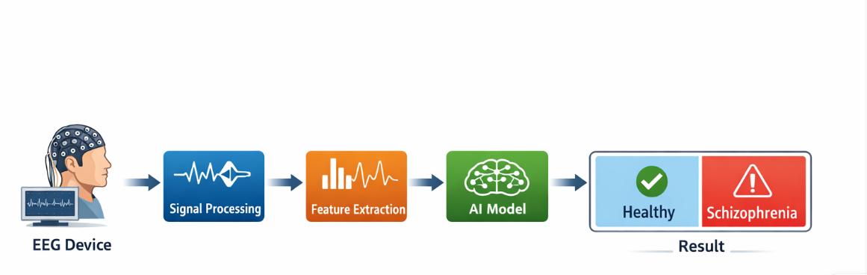
Process flow diagram

Slide 7
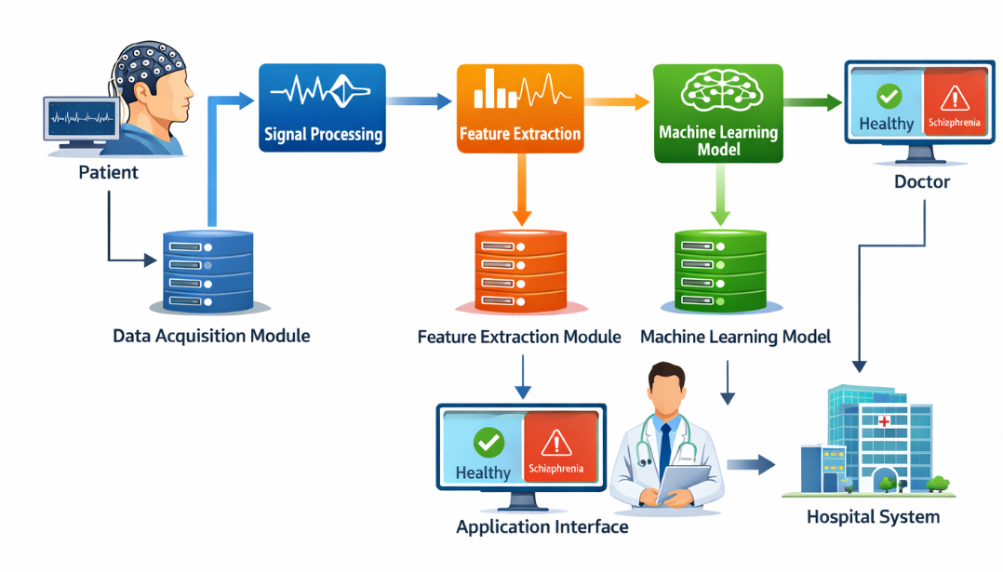
Architecture diagram of the proposed solution

Slide 8
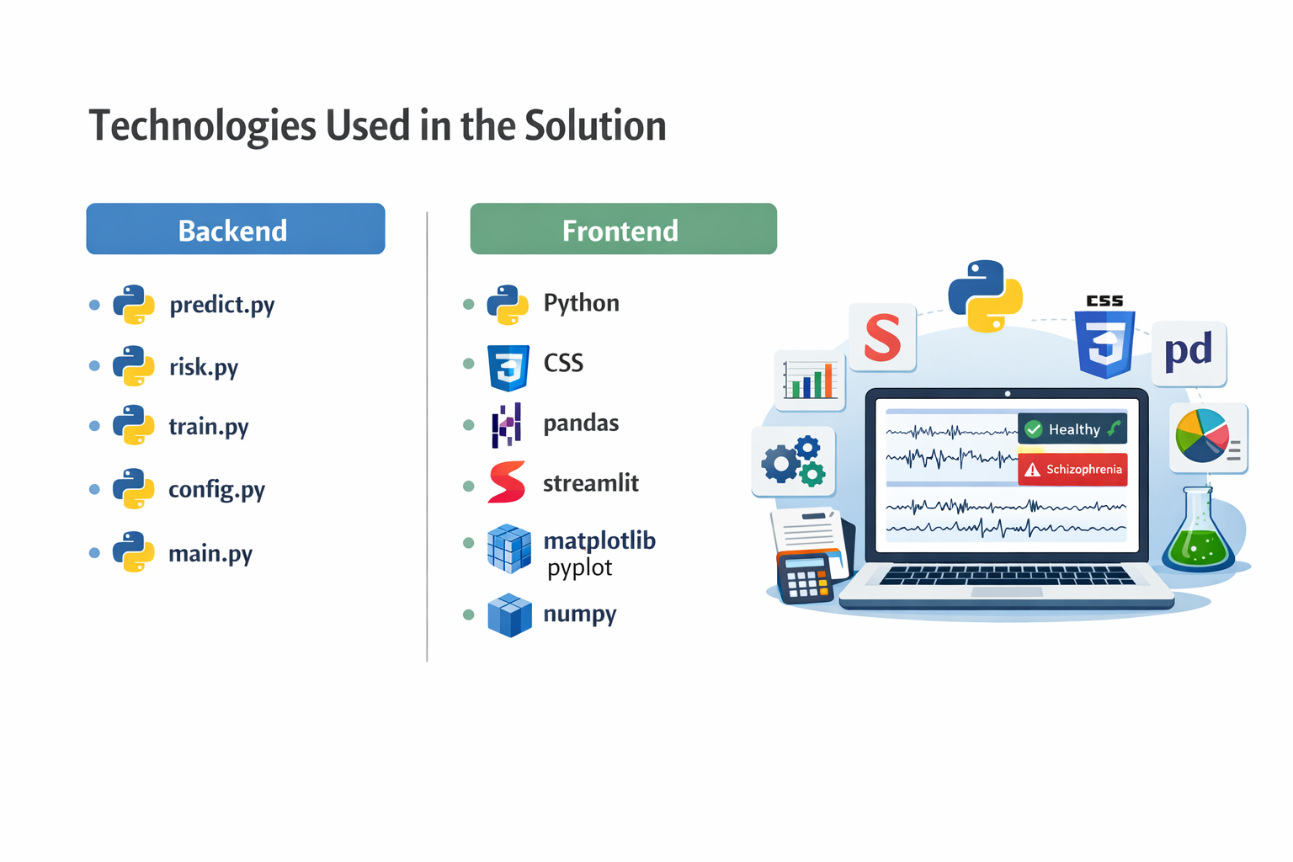
Technologies to be used in the solution:
Backend :
predict.py
risk.py
train.py
config.py
main.py
Frontend :
Python
CSS
pandas
streamlit
matplotlib.pyplot
numpy

Slide 9
Thank
You

